Slide 1

AyurSutra – Panchakarma Patient Management and Therapy Scheduling Software
Team Name : Bio Vision
Smart India Hackathon 2025 | Problem Statement ID: SIH25023

Slide 2
Problem Statement & Challenges
Manual Scheduling
Therapist & Room Conflicts
Disconnected Prescriptions
Confusion & delays in Ayurveda clinics.
Issues with multiple patient arrivals.
Doctor prescriptions not digitally linked to therapy.
Language Barriers
Lack of Audit Logs
No multilingual support for patients.
Missing transparency & accountability.

Slide 3

Proposed Solution: AyurSutra
Role-based login & online patient registration.
Integrated doctor consultation & digital prescription.
Automated therapist & room scheduling.
Multilingual UI support & patient feedback system.
Admin override with audit logs for transparency.
Patient Registration
Digital Prescriptions
Multilingual Support
Doctor Consultation
Automated Scheduling
Audit & Admin

Slide 4






Technical Approach & System Architecture
Technology Stack:
Frontend: React.js
Database: PostgreSQL / CockroachDB
Backend: Spring Boot + Quartz Scheduler
Hosting: Vercel (frontend), Render (backend)
Auth & Security: JWT + Spring Security
Frontend
Database
React.js UI served on Vercel
Postgres / CockroachDB storage
Client
Backend API
Notifications
Web & mobile apps (React)
Spring Boot + JWT auth
Queued messages & scheduler

Slide 5
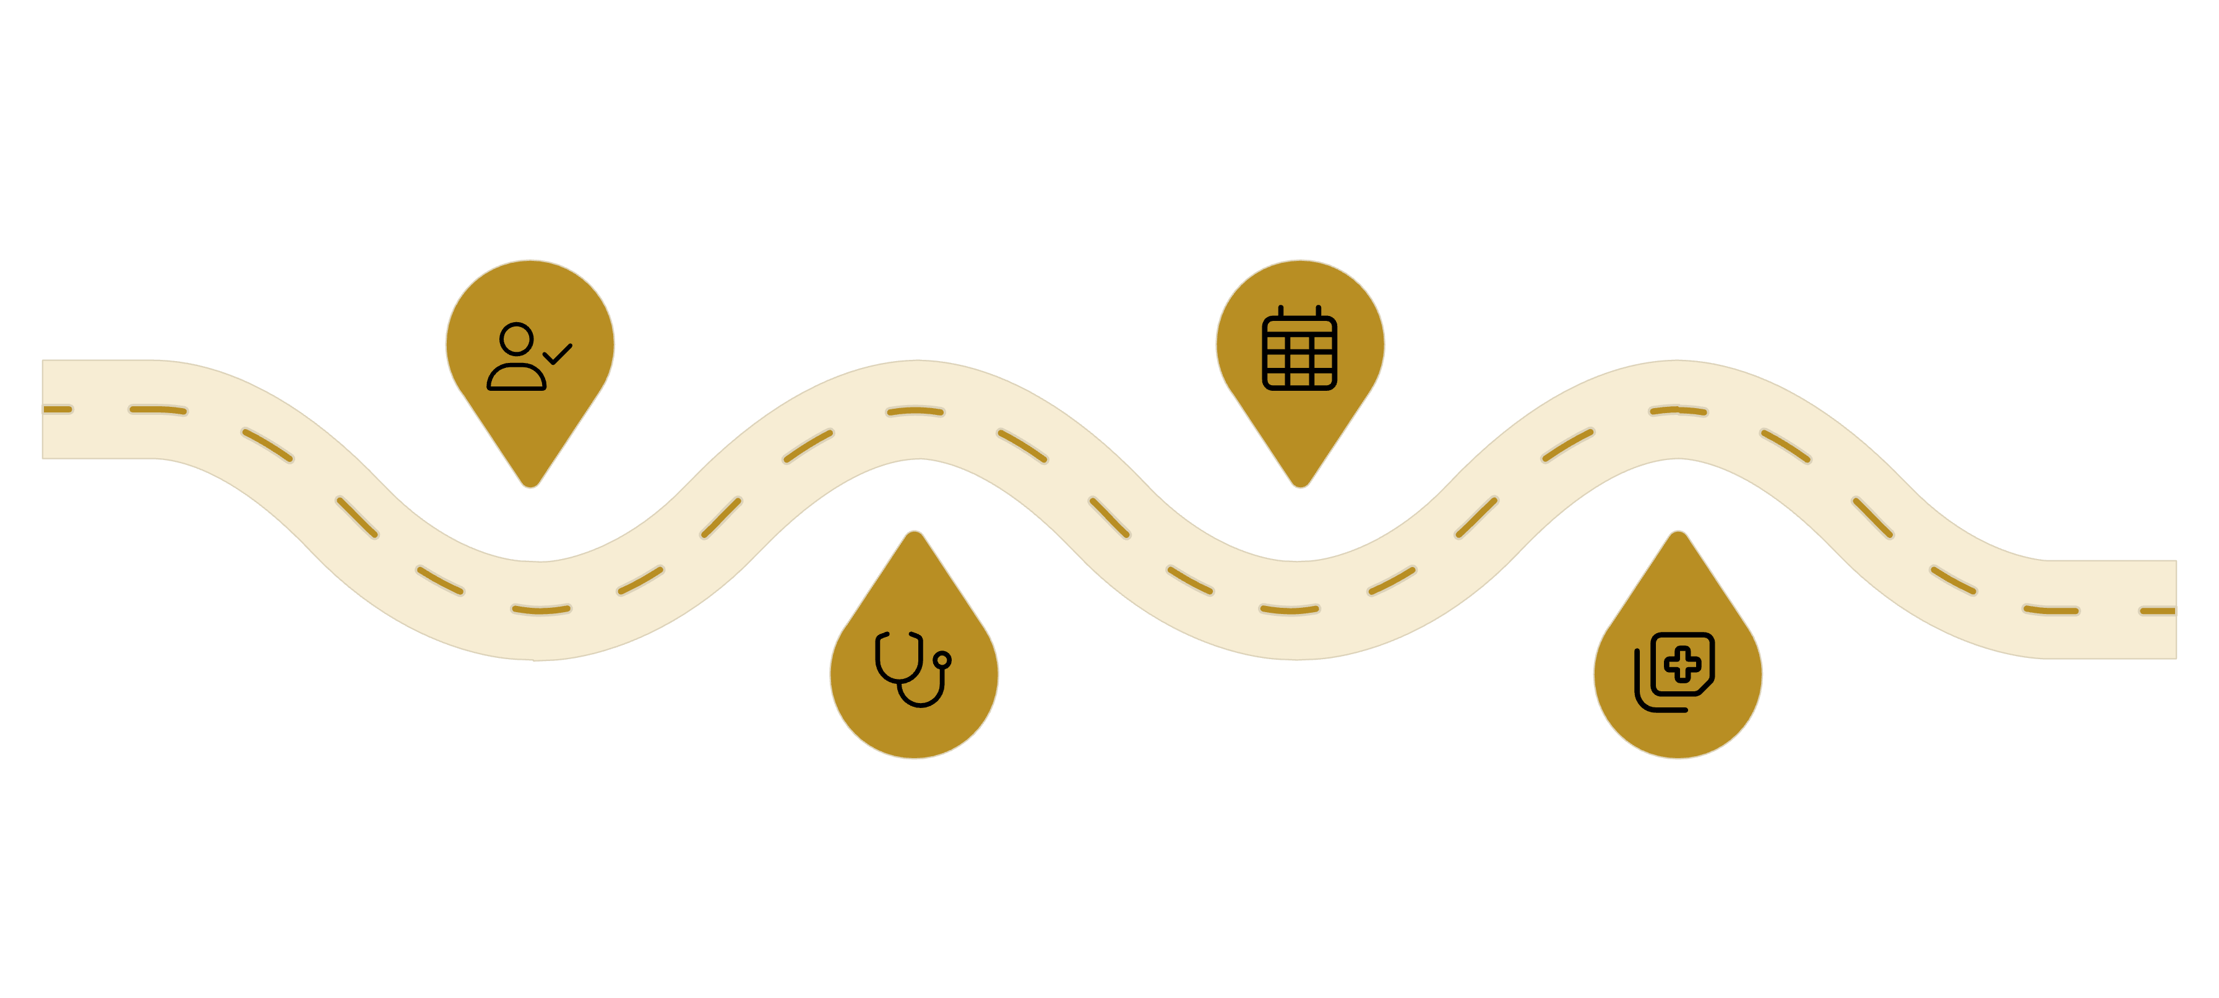

Workflow: Patient Journey
Registration
Scheduling
Online or offline signup and token
Auto-assign therapist and room
Consultation
Therapy & Feedback
Doctor consults and adds prescription
Session, therapist updates and feedback
01
02
03
Patient Registration
Doctor Consultation
Automated Scheduling
Online or offline, token generated.
Prescription entered into the system.
Therapist & room assigned.
04
05
Therapy & Feedback
Admin Monitoring
Session completion & multilingual star rating.
Overrides logged in audit trail.
04
05

Slide 6
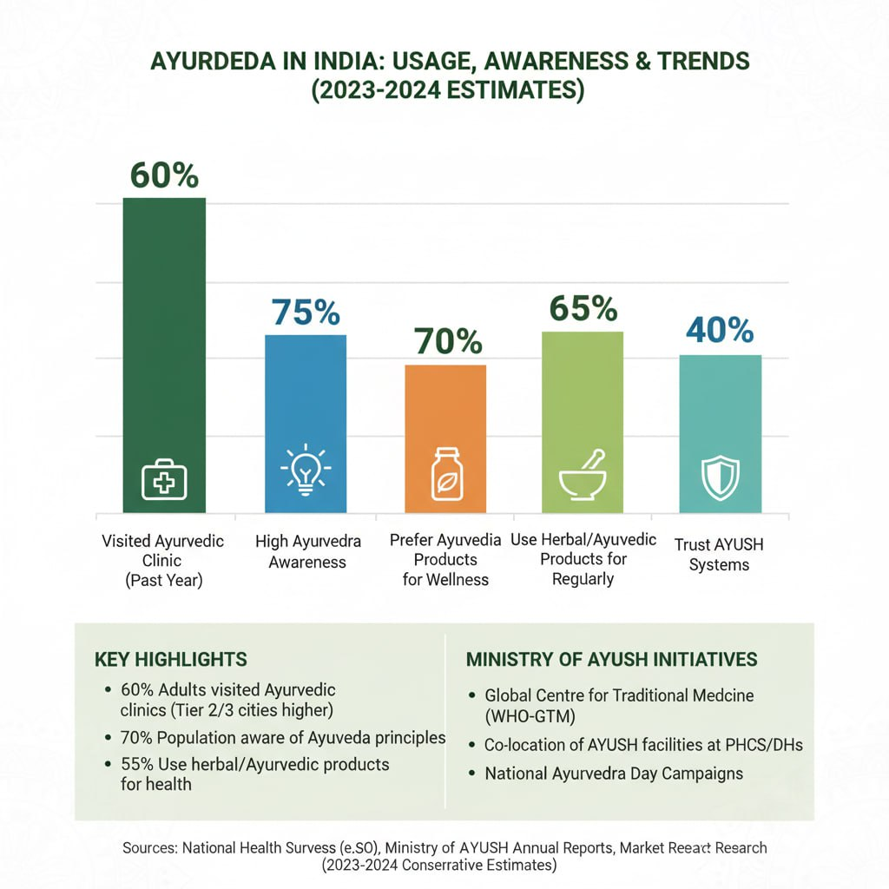
Feasibility & Viability
Growing Ayurveda adoption drives demand for efficient solutions.
The AYUSH market in India has grown from USD 2.85 billion in 2014 to
USD 43.4 billion by 2023.
The number of registered AYUSH practitioners is ~ 755,780
Govt. budget allocation to AYUSH has increased
(for FY26 ~Rs 3,992.9 crore vs ~Rs 3,497.6 crore previous year)
→ indicating rising investment.
Number of AYUSH beneficiaries in government hospitals and
dispensaries have risen from 2.5 Crores (FY2017-18) to
8.42 Crores (FY2022-23).
Challenges Addressed:
Automated scheduling resolves conflicts.
Online token system for patient convenience.
Simplified feedback ensures participation.

Slide 7





Impact & Benefits
Time Saved
Enhanced Security
Accountability
Automated scheduling reduces waiting time by 60%.
Role-based access ensures data protection.
Audit logs ensure transparency.
Inclusivity
Builds Trust
Multilingual UI supports rural patients.
Between patients and practitioners.
Backed by AYUSH growth stats, AyurSutra improves adoption in clinics and encourages digital health in traditional medicine.

Slide 8
Team Members
ID Number | Name
2300039056 | Vasanth Kumar Nimmiti
2300039055 | Mani Chandan Satya Venkata Sai Namana
2300039132 | Venkata Siva Naga Sai Siddiq Mulaveesala
2300039064 | Samba Siva Rao Pentakota
2300039124 | Hari Datti
2300030655 | Akshaya Sunkavalli

